Slide 1
WCF
Week 13

Slide 2




From Objects to Services
Object-Oriented
Polymorphism
Encapsulation
Subclassing
1980s
Component-Based
Interface-based
Dynamic Loading
Runtime Metadata
1990s
Service-Oriented
Message-based
Schema+Contract
Binding via Policy
2000s
Notes:
Speaker Notes
For years, software development has focused on how to best reuse the code that we write. Ultimately, people and businesses want long-term return on their short-term investments in code. How do we do this?
We’ve seen 3 waves of advancement in this movement in recent decades:
1980s and Object-Orientation: Object-oriented development promised the idea of building reusable abstractions (called classes) that we could then inherit from in order to reuse the base class functionality. This shift from simple procedural-based code brought with it a lot of benefits including polymorphism (the ability to dynamically bind types at runtime), abstractions that included both state and behavior, and encapsulation (controlling which parts of the code the external world can access). However, Object-Orientation by itself didn’t facilitate the dynamic evolution of software at runtime. Once an application was built, it was static. There wasn’t an easy way to infuse new code into an application.
1990s and Components: Component-based development helped us overcome this challenge. It forced the developer to think about the external facing interface of the application. This enabled us to build systems that dynamically load and bind to new functionality at runtime (an application discovers new components after it has been built) and introduced the notion of an application as a growing/evolving organism. To facilitate dynamic loading, we saw a big emphasis on runtime metadata. In the past, you couldn’t easily discern application capabilities since there was very little/rudimentary metadata information stored as part of the application. Whereas C and C++ programs from 1980s were these relatively opaque collections of code, component-based applications of the 1990s enabled runtime inspection of code to determine what a particular component supported. This introduced the notion of self-describing systems. But while this metaphor worked really well on a single machine (using method invocation on an object reference), we hit scaling problems when we tried to stretch it out and apply it as the substrate for distributed software integration (across machines, etc).
2000s and Service-Orientation – With Service-Orientation, we retain the benefits of self-describing applications, explicit encapsulation, and dynamic loading of functionality. What changes is the metaphor with which we accomplish it. Instead of using method invocation on an object reference, we shift the conversation to that of message passing – a proven metaphor for scalable distributed software integration. In addition, to support dynamic loading of service-based functionality, we use schema to describes the structure of messages, behavioral contract to define acceptable message exchange patterns, and policy to define service semantics.
Simplifying service-oriented development is one of the biggest bets we’re making in WCF. WCF takes the service-oriented concepts of message passing, schema, contract, and policy, and implicitly applies it to all of the services we build. As such, WCF provides you with the first true service-oriented programming model.
Transition to next slide:
We define service oriented applications as those that adhere to “The Four Tenets of Service-Orientation.” Let’s examine these and see how WCF implements them…

Slide 3

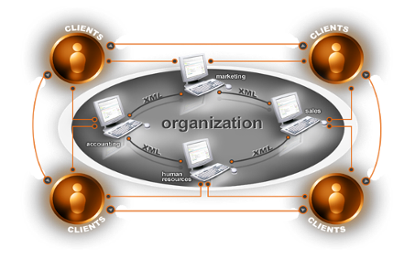
The Challenge Radically Simplifying Distributed Application Development
Different programming models for different tasks
Need for security and reliable messaging
Interoperability with applications on other platforms
Productive service-oriented programming model needed
Development of connected systems remains costly and frustrating
Notes:
Speaker Notes
The next challenge we face is actually something we’ve been doing for quite some time now – building distributed applications.
As developers, we’ve been building distributed applications for years now. However, I’ll assert that it’s never been as easy as it should be, or could be.
While our ability to build distributed applications has certainly changed over the past few years, it hasn’t necessarily gotten any easier. In fact, additional capabilities and options for building distributed applications have brought with them additional complexity!
Security is critical for applications, but often complicated to implement.
Standards-based interoperability needs to be taken into account for communication across heterogeneous systems.
We have different programming models with different capabilities that are focused on different application scenarios: Web services, distributed objects, and message queuing all helped address development needs, but again, they’ve added more complexity to our lives. They require us to learn different programming paradigms and often contain functionality and features that don’t compose (combine) well with one another.
With the resurgence of service orientation and service-oriented architectures (SOA), we also need to design our applications for flexibility in the face of change.
It was these types of development challenges in building distributed applications that drove the WCF product design goals.
Transition to next slide:
So at a high level, the goal of WCF is to radically simplify the development of distributed applications. We can summarize WCF’s design goals in three key concepts…

Slide 4
Windows Communication Foundation (WCF)
Windows Communication Foundation (WCF) is used to create a distributed and interoperable Application
WCF is used to exchange messages using any format via any transport protocol like HTTP, TCP/IP, MSMQ, Named Pipes and and so on
Its default format is SOAP
A Web Service that can be consumed by different clients

Slide 5
Why do we need WCF?
Why do we need WCF when we already have ASMX Web Services?

Slide 6
Why do we need WCF?
Why do we need WCF when we already have ASMX Web Services?
Problem: Suppose we have two clients. One wants to use a Web Service, which sends data over the network, using Http protocol and want reply in XML format and the other wants to send the data using TCP protocol and replying in binary format
We’ll need to create two different services for two different clients

Slide 7
Why do we need WCF?
Solution: WCF!
It allows you to develop applications that can communicate using different communication mechanisms
It can use any transport protocol like HTTP, TCP/IP, MSMQ, Named Pipes
It supports different hosting

Slide 8
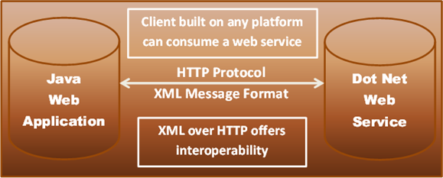
Example 1

Slide 9
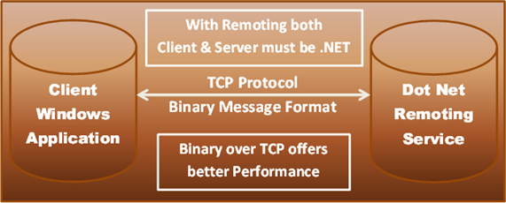
Example 2

Slide 10
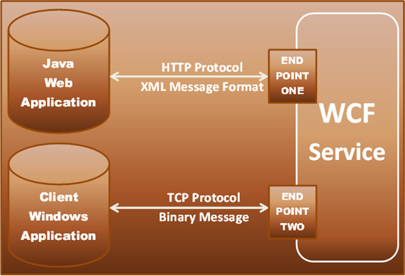
WCF Solution

Slide 11
Understanding WCF principles

Slide 12



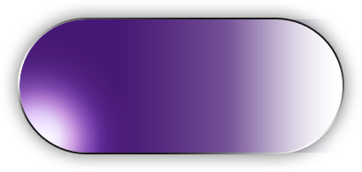
Services and Clients
Client
Service
Message
Message

Slide 13

Endpoints
Client
Service
Endpoint
Endpoint
Message
Endpoint

Slide 14
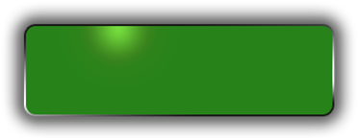






Address, Binding, Contract
Client
Service
Endpoints
Endpoint
C
B
A
C
B
A
Message
C
B
A
Address
Binding
Contract
(Where)
(How)
(What)

Slide 15
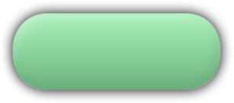
WCF Architecture: Messaging Runtime
Service
Contract
and Behaviors
Client
Dispatcher
Protocol(s)
Protocol(s)
Binding
Encoder
Encoder
Transport
Transport
Address

Slide 16
Address
The Where

Slide 17
Address
Basically URL, specifies where this WCF service is hosted. Client will use this URL to connect to the service
Example: http://localhost:8090/MyService/SimpleCalculator.svc

Slide 18
Contracts
The What

Slide 19
Contracts
In WCF, all services are exposed as contracts. A contract is a neutral way of describing what the service does
There are four types of Contracts:
Service Contract
Data Contract
Message Contract
Fault Contract

Slide 20
Service Contract
This contract describes all the available operations that a client can perform on the service.
[ServiceContract] attribute is used to define the service contract. We can apply this attribute on class or interface. ServiceContract attribute exposes a CLR interface (or a class) as a WCF contract. [OperationContract] attribute is used to indicate explicitly which method is used to expose as part of WCF contract. We can apply OperationContract attribute only on methods, not on properties or indexers. [ServiceContract] applies at the class or interface level [OperationContract] applies at the method level

Slide 21
Service Contract
[ServiceContract]
public interface IService1
{
[OperationContract]
string GetData(int value);
double Hello(string s);
[OperationContract]
int Sum(int a, int b);
}

Slide 22
Data Contract
This contract defines the data types that are passed into and out of the service.
[DataContract] attribute is used at the custom data type definition level, i.e. at class or structure level
[DataMember] attribute is used for fields, properties, and events

Slide 23
Data Contract
[DataContract]
public class CompositeType {
bool boolValue = true;
[DataMember] public bool BoolValue {
get { return boolValue; } set { boolValue = value; } }
}

Slide 24
Message Contract
This contract provides direct control over the SOAP message structure. This is useful in interoperability cases and when there is an existing message format you have to comply with. [MessageContract] attribute is used to define a type as a Message type [MessageHeader] attribute is used for those members of the type we want to make into SOAP headers [MessageBodyMember] attribute is used for those members we want to make into parts of the SOAP body of the message

Slide 25
Message Contract
[MessageContract]
public class ComplexProblem
{
[MessageHeader] public string operation;
[MessageBody] public ComplexNumber n1;
[MessageBody] public ComplexNumber n2;
[MessageBody] public ComplexNumber solution;
// Constructors…
}
Notes:
SO principles mean that designers should plan to exchange messages rather than procedure calls.
The two styles of developing using WCF are RPC style where messages are generated using traditional procedure calls, but another mode of operation is available to users where they are cognizant of the messages being generated and want to control the SOAP encapsulation of the content that is being generated. Defining a message contract on a service means that the end user

Slide 26
Three Types of Contracts
Service Contract
Defines Operations, Behaviors and Communication Shape
Data Contract
Defines Schema and Versioning Strategies
Message Contract
Allows defining application-specific headers and unwrapped body content
What does your service do
What object data is used
Allows control over the SOAP structure of messages

Slide 27
Bindings
The How

Slide 28
Bindings
It describes the way or mechanism by which the user will communicate with Web Service
It is nothing but a set of choices regarding the transport protocol, message encoding, communication pattern (whether communication is asynchronous, synchronous, message queued etc.), security protocols
WCF supports 9 bindings

Slide 29
Bindings & Binding Elements
Binding
HTTP
Text
Security
Reliability
TX
Transport
Encoders
Protocol
TCP
HTTP
Text
Security
Reliability
MSMQ
IPC
Binary
TX
.NET
Custom
Custom
Custom
Notes:
TX = Transaction Protocol

Slide 30
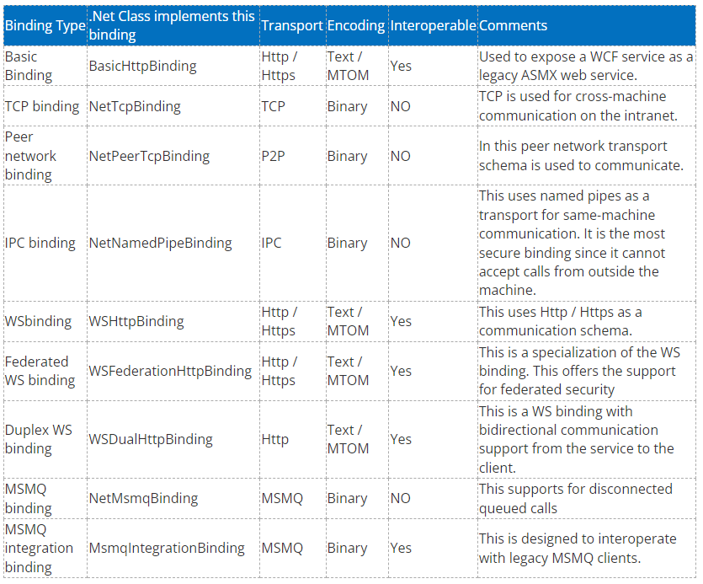
Bindings

Slide 31
Ways to Talk
One Way
Client
Service
Request-Reply
Duplex (Dual)
One Way:
Datagram-style delivery
Request-Reply
Immediate Reply on same logical thread
Duplex
Reply “later” and on backchannel (callback-style)

Slide 32
Hosting
Hosting is the important thing in WCF Application and it makes WCF Application different from other distributed Applications. WCF supports following types of hosting-
IIS Hosting
Self hosting
WAS hosting

